Slide 1


Career Recommendation Model for Kenyan High School Students
Name: Mwaniki Tifany Nyawira

Slide 2

Question….
Do you remember how much of a hustle choosing a career path or a course after finishing High school was?
Many student’s struggle to select a career that aligns with their personal interests as well as their academic performance.

Slide 3
What problem does this solve?
Lack of structured Career Counseling in Kenyan Schools
Mismatch between academic performance, personal interests and career paths
Career choices influenced by peers or parents.
Limited exposure and awareness to the wide range of career options available – Many students are unaware of emerging career opportunities that align with their skills and interests.

Slide 4
Solution
An AI based career recommendation system offering personally tailored recommendations based on the students interests and academic performance.
Exposure to a Wide Range of Career Options.
Dynamic suggestions with continuous input as students can update their academic data and interests over time.
Virtual advisor accessible anytime

Slide 5
Product
Platform: CareerWiz – An AI based career recommendation system
- Features:
User login/registration
Academic + interest data input
AI-based recommendations
Feedback loop for improvement
- Tech stack: React, Node.js, Python, PostgreSQL

Slide 6

Target Market
Primary:
Form 3 & 4 high school students.
Students who have finished their KCSE.
Secondary:
Educational Institutions that want to offer career counseling solutions to students.
Parents/Guardians who want data-driven guidance for their children’s career choices.
Ministry of education.
NGOs, EdTech partners & Organization focused on youth empowerment.
Career development initiatives and programs.
Organizations looking to sponsor students for career training and mentorship programs.

Slide 7
Market Size
- 3+ million high school students in Kenya
- Less than 15% access formal career guidance
- High potential for East African expansion
- Rising school-level digital adoption.

Slide 8
Competitors
- Western-based career platforms
- Traditional counselors
- Google Forms aptitude tools
BUT hey, none are tailored for the Kenyan job market or courses offered in the Kenyan Institutions!

Slide 9
Competitive Advantage
- Kenyan curriculum-specific
- Local job market integrated
- AI-powered + feedback based
- Scalable, data-driven, personalized

Slide 10
Traction & Roadmap
So far:
- Prototype developed
- Pilot in 1 school completed
- Successful testing
Next:
- Expand to 10+ schools
- Add parent dashboards
- Integrate mentorship support

Slide 11
Business/Revenue Model
- Freemium access for students
- Paid Subscription Model for Schools & Institutions.
- NGO/CSR sponsorships
- Data insights for educational partners
Career advisors Subscription
Advertising & University Partnerships for referrals to study in these Universities

Slide 12
Go-to-Market Strategy
- Collaborate with Ministry of Education
- Launch through school/NGO partnerships
- Campaigns: school visits, social media
- Incentives: free reports, mentorship access

Slide 13
Social Impact
🎯 SDG 4: Quality Education
Promotes inclusive and equitable quality education by guiding students toward suitable academic and career paths by encouraging informed decision-making, reducing dropouts due to misaligned courses.
🎯 SDG 8: Decent Work and Economic Growth
Prepares students for careers aligned with market demands, contributing to a skilled and job-ready workforce by linking academic strengths to viable professions.
🎯 SDG 10: Reduced Inequalities
Offers equal access to career guidance for students in both urban and rural areas bridging the gap caused by lack of counseling resources in underfunded schools.
🎯 SDG 9: Industry, Innovation, and Infrastructure
Leverages AI and digital tools to modernize educational and guidance systems and encourages innovation in how career guidance is delivered and personalized.

Slide 14
Our Ask
Assistance with securing school and NGO partnerships.
Tech support to gather more data for training the Model.
Mentorship and guidance for the development team.
Funding for expansion.

Slide 15

Platform Scaling & Infrastructure​ ie Hosting, server, and cloud storage costs (backend, ML model deployment)​ to Improving performance to handle more users (especially during school-wide rollouts)​
Product Development​ through Enhancing features like personalized dashboards, parental insights, and student tracking​ and developing a mobile app for broader access
User Testing & Pilot Programs​ through partnering with more schools for pilot deployment, workshops, clinics and training​
Marketing & Awareness Campaigns​ Outreach to schools through workshops, events, social media​ to create career awareness content for students and guardians​
Team Expansion via​ Hiring additional developers, data scientists, and UI/UX designers​
Data Acquisition & Licensing​ for Integrating up-to-date labor market data and university course databases​
Partnering with education boards for structured academic input​.
Mentorship & Student Support​ by setting up a mentorship portal that connects students with professionals
Funding Needs for CareerWiz​​

Slide 16
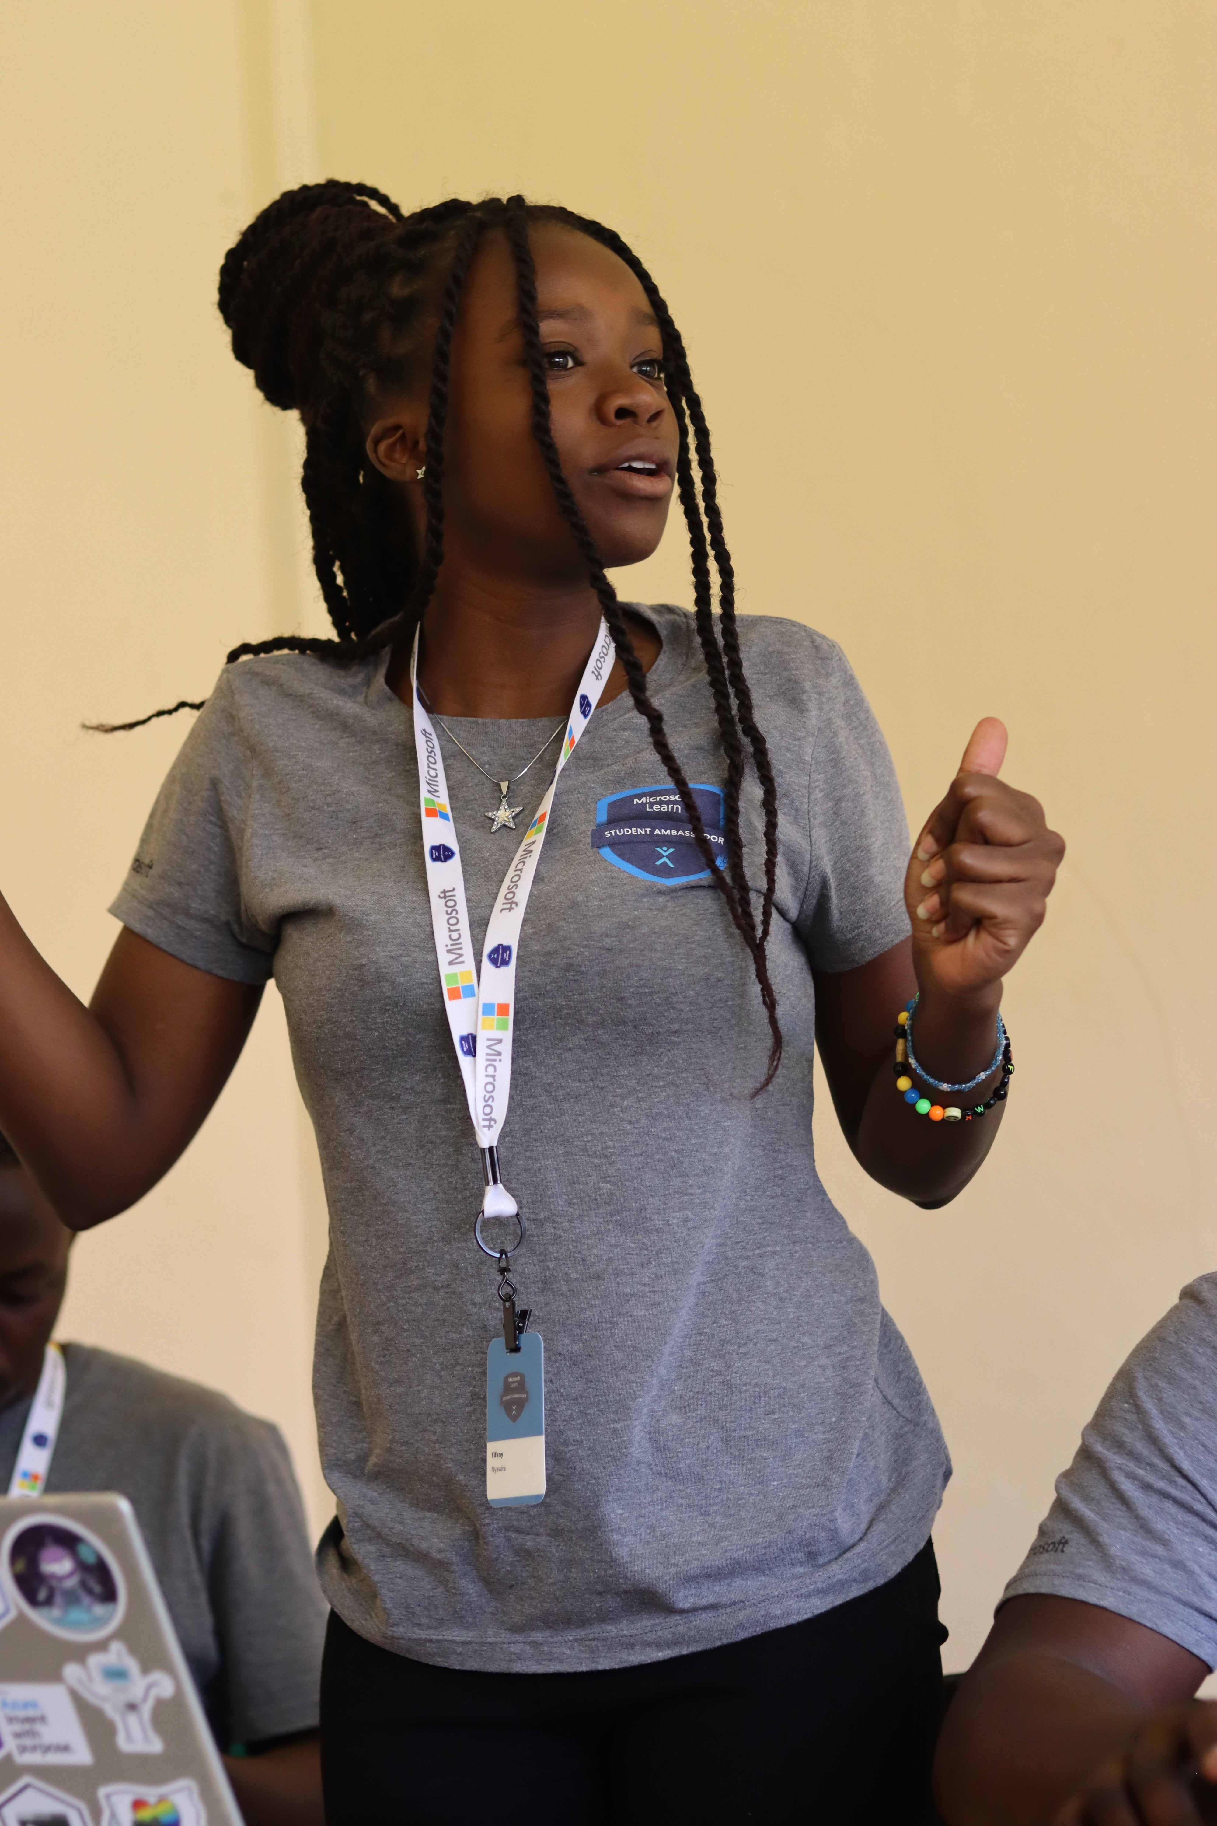

Our Team
Mwaniki Tifany Nyawira
Magdalene Komu
System Developer
Academic Guide and Career Counselor

Slide 17



Thank you.
Mwanikitiffany25@gmail.com LinkedIn – Tifany Nyawira
Contact - 0797677629

